Slide 1
3D-CHESS: Decentralized, Distributed, Dynamic, and Context-aware Heterogeneous Sensor Systems
PI: Daniel Selva (Texas A&M University)
Co-Is: George Allen (Virginia Tech), Huilin Gao (Texas A&M University), Ankur Mehta (UCLA), Yizhou Sun (UCLA), Vinay Ravindra (ARC/BAERI), Cedric David (JPL)
Students: Alan Aguilar, Ben Gorr, Chrissi Erwin, Molly Stroud, Vivian Cheng, Zida Wu, Wooyeong Cho
AIST-21-0089 Progress Update
January 30, 2023

Slide 2
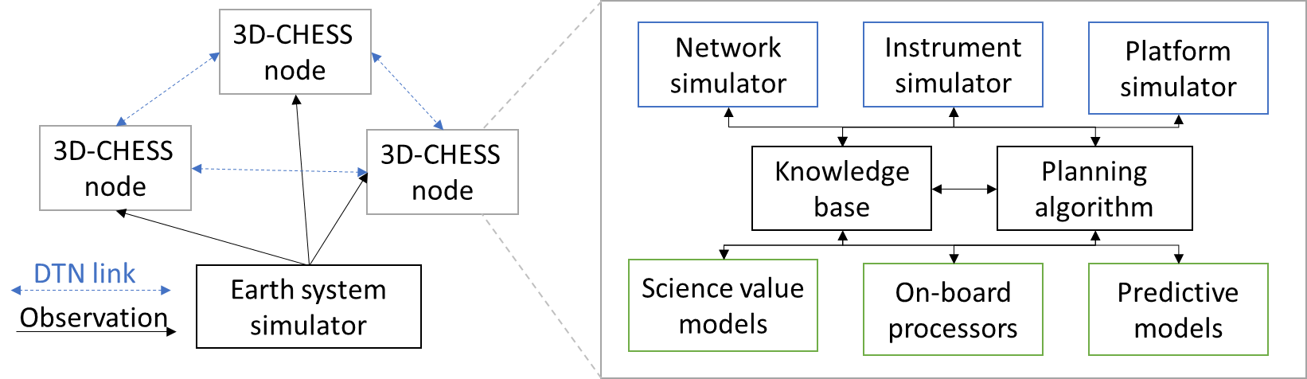
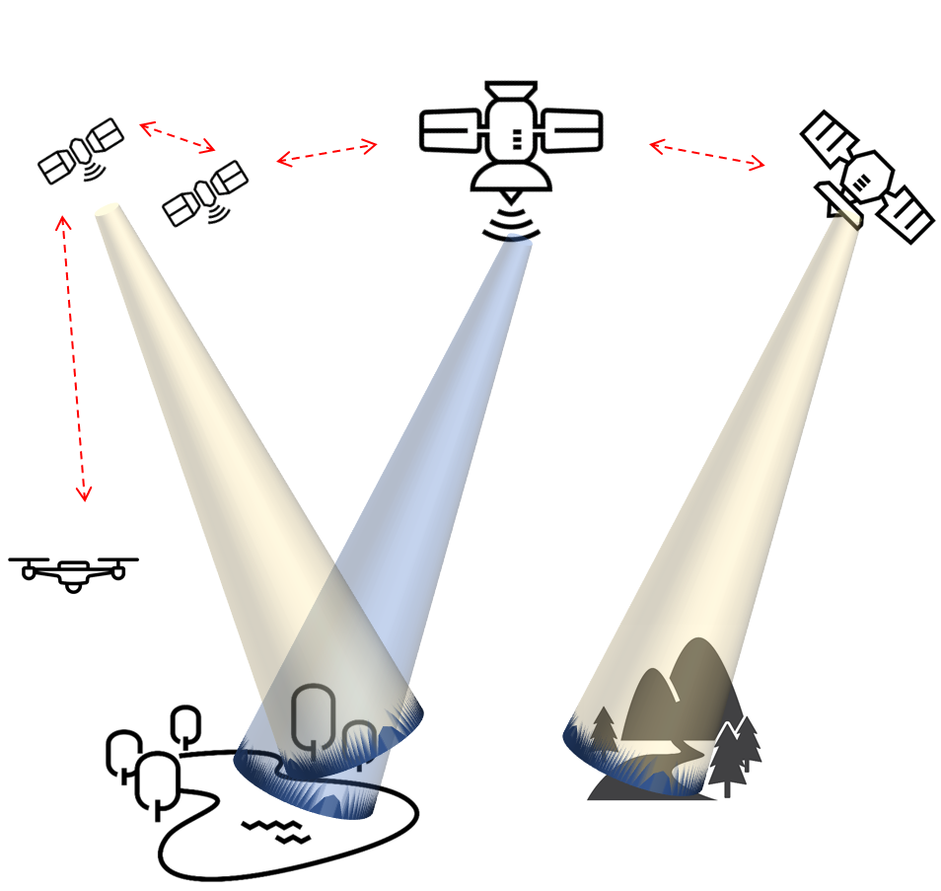


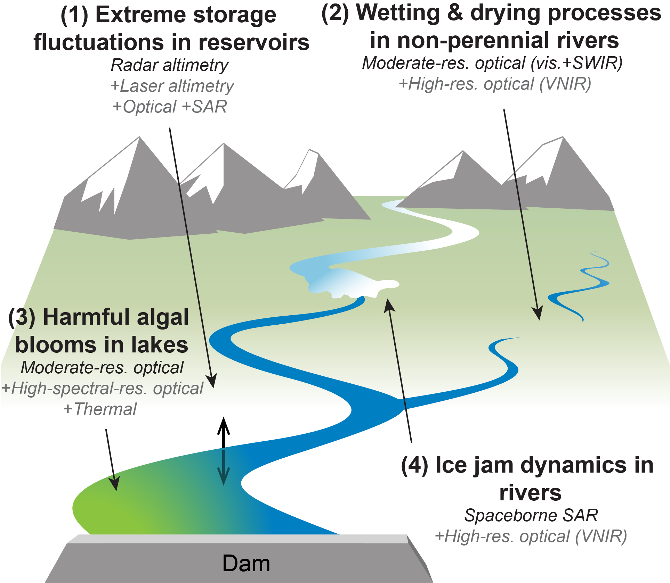
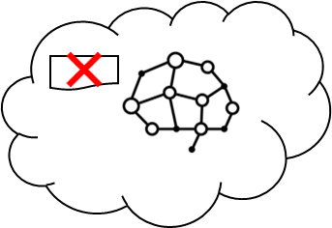
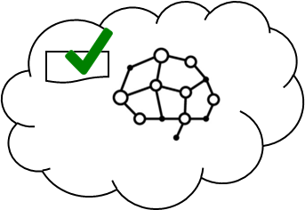
3D-CHESS: Decentralized, Distributed, Dynamic, and Context-aware HEterogeneous Sensor Systems
PI: Daniel Selva, Texas A&M University
Objective
Demonstrate proof of concept (TRL 3) for a context-aware Earth observing sensor web of interconnected space, air and ground nodes.
Context awareness: ability for the nodes to gather, exchange, and reason about contextual information (e.g., state of the observable, state and capabilities of itself and of other nodes in the network and how those relate to the task request and mission objectives).
Demonstrate the technology and assess the value of contextual information in a multi-sensor in-land hydrologic and ecologic monitoring system with four inter-dependent mission objectives: studying intermittent rivers and sediment transport, and monitoring floods and algal blooms
Approach
Key Milestones
Knowledge graph reasoning using UniKER algorithm allows nodes to determine if they can perform a task
Decentralized planning using modified CCBBA algorithm
Platform/Instrument/Network simulators using existing tools (PyOrbit, InstruPy, and dtnSim) provide realistic engineering constraints to planning algorithms
Simple science models provide reasonable science-driven estimates of scientific/societal value of observations to planning algorithms
Multi-agent simulation to benchmark 3D-CHESS against status quo and intermediate “transition” architectures
Kick-off 08/22
System architecture/interfaces defined 11/22
Initial Integration and verification complete 01/23
Performance in basic case characterized (TRL 2) 03/23
Value of technology characterized in basic case 09/23
Multi-mission use case demonstrated (TRL 3) 11/23
TRL_{in} = 1-2
TRL_{current} = 1-2
Co-Is/Partners: George Allen (VT); Huilin Gao (TAMU); Ankur Mehta, Yihzou Sun (UCLA); Vinay Ravindra (ARC); Cedric David (JPL).
11/21
AIST-21-0089

Slide 3
Presentation Contents
Logistics: Financials, Schedule, Team, TRL assessment
Technical Objectives
3D-CHESS tool development
Preliminary results
Next steps
Backup: List of Acronyms, Response to Review Panel Comments

Slide 4
LOGISTICS

Slide 5
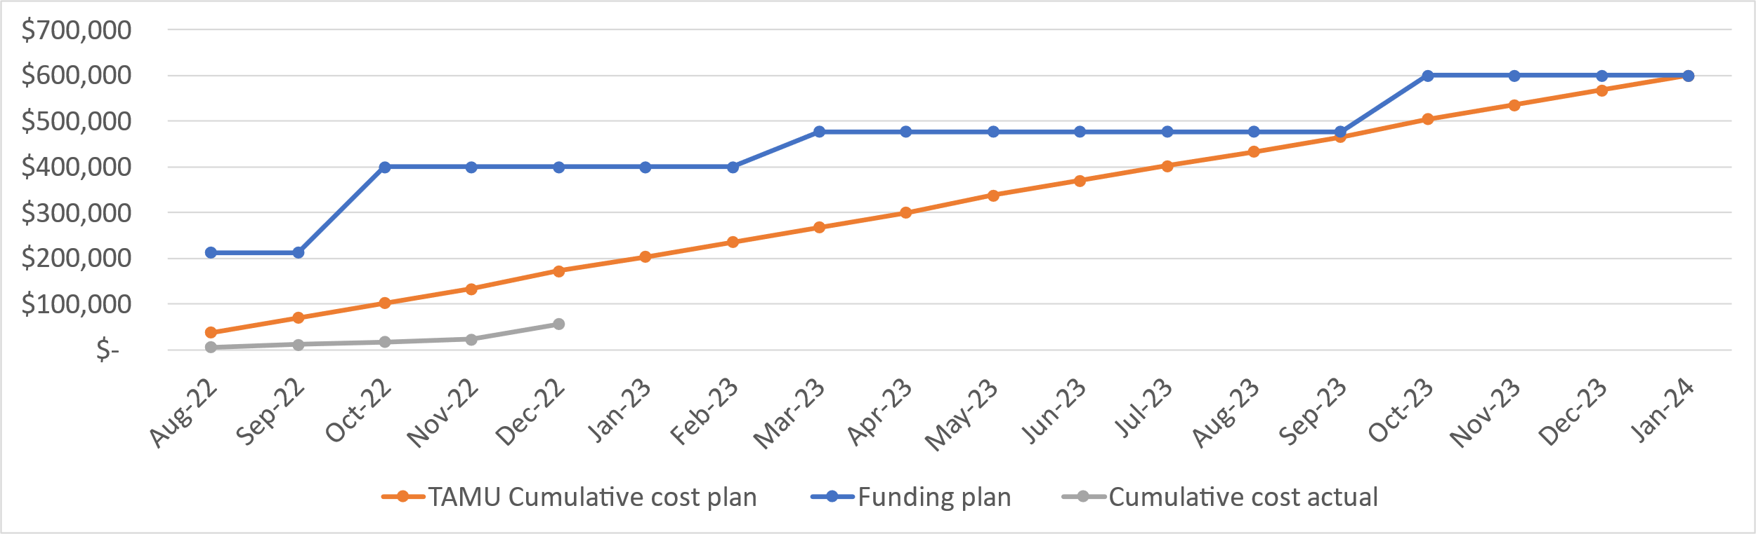
Costs Status and Plan
Delay in TAMU award and UCLA/VT sub-awards has led to delays in spending.
Expect this to regularize over the next few months

Slide 6
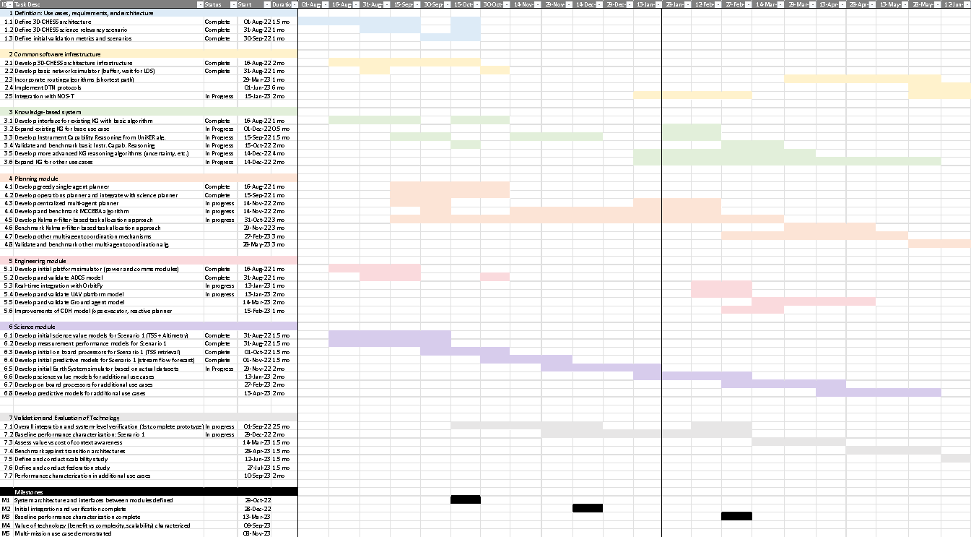
Project Schedule
On time except for slight delay with integration of MCCBBA decentralized planning algorithm

Slide 7
Team Members: Senior Personnel
Team member | Role | Affiliation | Responsibilities
Daniel Selva | PI Space Systems | TAMU | Project management Lead definition of 3D-CHESS architecture, use cases, and validation strategies Coordinate overall scientific direction
George Allen | Co-I Earth Science | Virginia Tech | Lead inland water system application Lead development of science value models (ice jams and non-perennial river drying and wetting processes)
Huilin Gao | Co-I Earth Science | TAMU | Define 3D-CHESS relevance scenario mission Lead development of science value models (reservoir storage and lake algal blooms)
Cedric David | Co-I Earth Science | JPL | Coordinate use of RAPID model in 3D-CHESS Guide 3D-CHESS science application scenario
Ankur Mehta | Co-I Electrical Engineering | UCLA | Lead development of decentralized estimation and multi-agent coordination aspects
Yizhou Sun | Co-I Computer Science | UCLA | Lead development of the knowledge graph, knowledge extraction, and knowledge graph reasoning algorithms
Vinay Ravindra | Co-I Space Systems | NASA ARC | Develop interfaces between 3D-CHESS and EO-Sim Provide input into overall architecture and application to relevance scenario

Slide 8
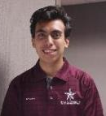






Team Members: Students and Post-Docs
Molly Stroud, (Ph.D. student, Virginia Tech; science algorithms and use case definition).
Alan Aguilar Jaramillo, (Ph.D. student, Texas A&M University; Lead Developer).
Kewei (Vivian) Cheng, (Ph.D. student, University of California Los Angeles; Knowledge base and reasoning algorithms).
Ben Gorr, (Ph.D. student, Texas A&M University; Co-Lead Developer).
Zida Wu, (Ph.D. student, University of California Los Angeles; multi-agent estimation and coordination algorithms).
Chrissi Erwin, (M.S. student, Texas A&M University; Planning algorithms).
Wooyeong Cho, (Ph.D. student, University of California Los Angeles; multi-agent estimation and coordination algorithms).
Notes:
Add Wooyeong Cho

Slide 9
TRL Assessment
Component | Entry TRL | Exit TRL | Justification
Autonomous and context-aware EOS (overall 3D-CHESS technology) | 1 | 3 | While some of these capabilities are at higher TRL individually, they have never been integrated in the proposed way.
Knowledge graph | 2 | 3 | A similar knowledge graph was developed by the Co-Is in a past DARPA project [1] but it needs to be expanded.
Knowledge reasoning algorithms | 2 | 3 | The UniKER algorithm was developed by the team [2] and applied to a similar problem in a past DARPA project [1], but it needs to be adapted for this application.
Decentralized planning algorithms | 2 | 3 | The MCCBBA algorithm was developed by the team [3] for a similar problem, but needs to be adapted to this problem.
Engineering module | 2 | 4 | The platform and instrument simulator are all based on existing tools (OrbitPy, InstruPy) that have been integrated in in a similar way (EOSim [4]), but they need to be adapted.
Science module | 1 | 3 | Some components of this simulator exist (e.g., RAPID model developed by Co-I David [5], science score function developed as part of TAMU X-grant project), but they need to be integrated for this application.
[1] Viros i Martin, A., Cheng, K., Zheng, Z., Fang, A., Kress-Gazit, H., Mehta, A., Sun, Y., & Selva, D. (2021). Decentralized Context-Based On-Board Planning for Earth Observation Missions. AIAA Scitech 2021 Forum.
[2] Cheng, K., Yang, Z., Zhang, M., & Sun, Y. (2021). UniKER: A Unified Framework for Combining Embedding and Definite Horn Rule Reasoning for Knowledge Graph Inference. Proceedings of the 2021 Conference on Empirical Methods in Natural Language Processing, 9753–9771.
[3] Gallud Cidoncha, X., & Selva, D. (2018). Agent-based simulation framework and consensus algorithm for observing systems with adaptive modularity. Systems Engineering, 21(5), 432–454. https://doi.org/10.1002/sys.21433
[4] Ravindra, V., Ketzner, R., & Nag, S. (2021). Earth Observation Simulator (EO-Sim): An Open-Source Software for Observation Systems Design. 2021 IEEE International Geoscience and Remote Sensing Symposium IGARSS, 7682–7685.
[5] David, C. H., Maidment, D. R., Niu, G.-Y., Yang, Z.-L., Habets, F., & Eijkhout, V. (2011). River Network Routing on the NHDPlus Dataset. Journal of Hydrometeorology, 12(5), 913–934. https://doi.org/10.1175/2011JHM1345.1
Notes:
http://www.wolframalpha.com/input/?i=days+since+10th+October+2011

Slide 10
TECHNICAL OBJECTIVES

Slide 11
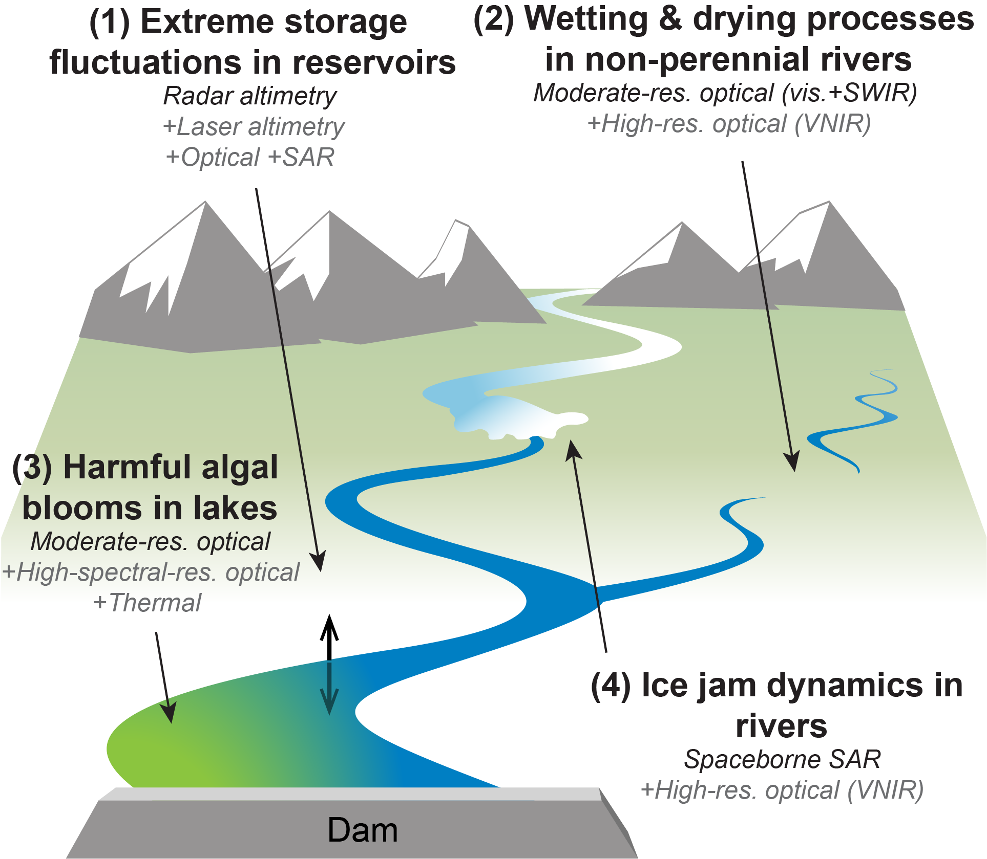
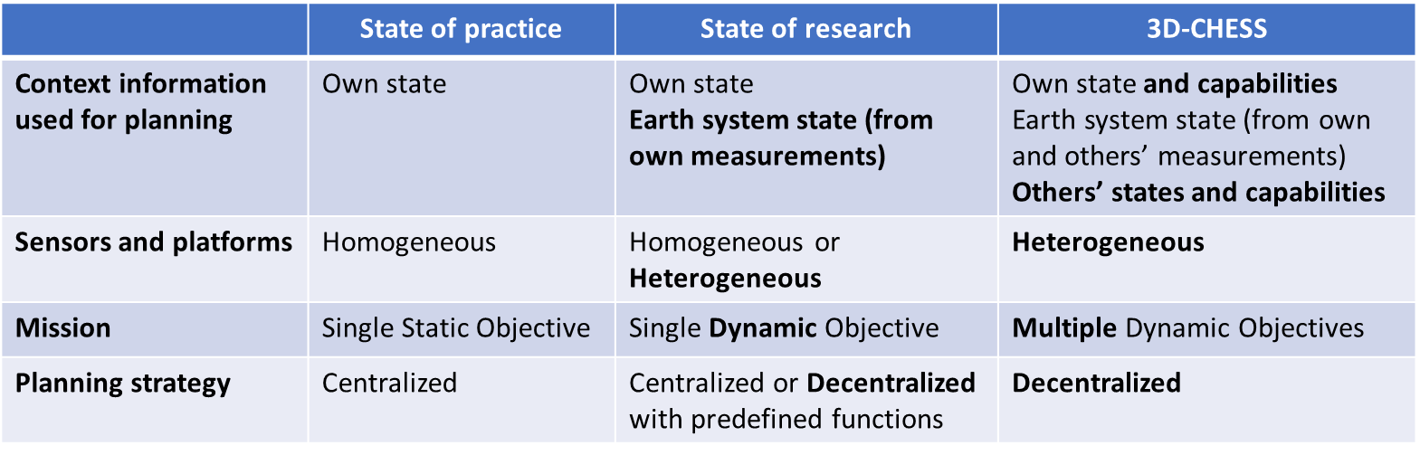
Background/Objectives
Overarching Goal: To provide proof of concept (TRL 3) for a context-aware network of heterogeneous sensors, in the context of an inland water ecosystem monitoring mission
Inland water bodies can dramatically change states within minutes to hours.
These changes are increasingly extreme and difficult to predict due to climate change.
Need for high spatial, temporal, and/or spectral resolutions, from heterogeneous sensors.
To monitor and respond to a dynamic environment, significantly more autonomy is needed in the Earth observing systems.
Autonomy requires context awareness and decentralized coordination.
Relevant to Objective O1: Enable new observation measurements and new observing systems design and operations through intelligent, timely, dynamic, and coordinated distributed sensing.
Relevant missions: SWOT, NISAR, Delta-X, SMASH

Slide 12
Background / Objectives
Enabling technologies: Knowledge graph reasoning algorithms (UniKER) and decentralized planning algorithms (MCCBBA).
Approach: Multi-agent simulation (message-driven) where each node consists of
Engineering module (platform, sensors, and network simulators) using EOSim
Science module (science value models, on-board processors, predictive models)
Planning module (knowledge-based reasoning, planning/scheduling)
Objectives: Use multi-agent simulator to assess feasibility, scalability and value of the 3D-CHESS concept vs various benchmarks in the context of the relevance scenario
Quantify the value of implementing 3D-CHESS compared to the status quo
Study “transition” architectures (somewhere btw. 3D-CHESS and status quo)
Study “federated” architectures (nodes owned & operated by different agencies)

Slide 13
3D-CHESS: Concept of operations
1 – Default missions; data processing
Each node in the system conducts its nominal mission, following a default plan (e.g., provide global coordinated observations of inland water quantity and quality.)
Nodes can be in space, air, or ground, and they can perform one or more functions (observation, data processing, communication)
Nodes with data processing capabilities process the data on board in real time and look for events of interest.

Slide 14
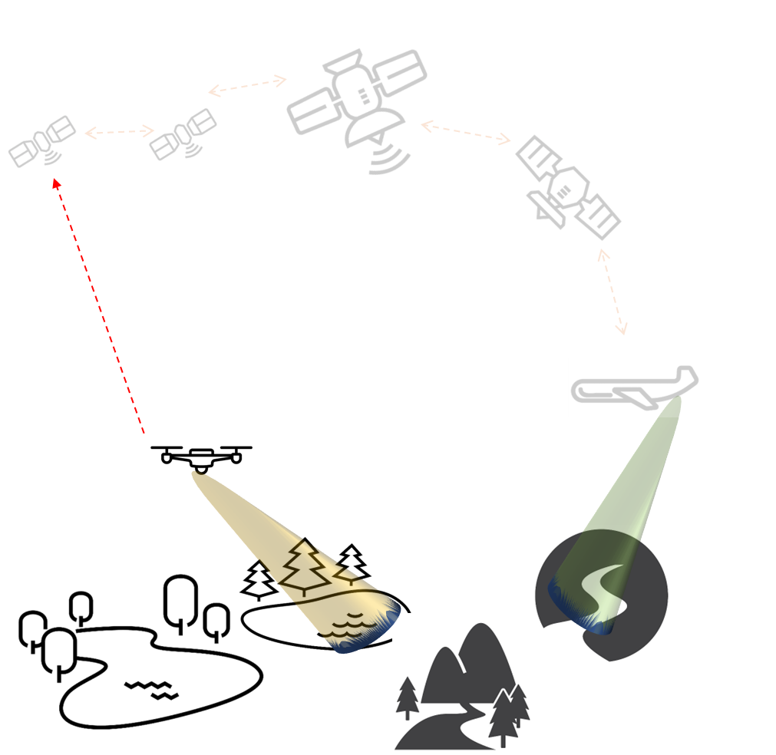
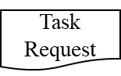
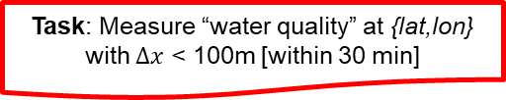

3D-CHESS: Concept of operations
2 – Event detected; task request sent
A node in the network detects (or predicts) an event of interest (e.g., a flood or a new intermittent river) at a certain location.
It sends a Task Request to the network.

Slide 15
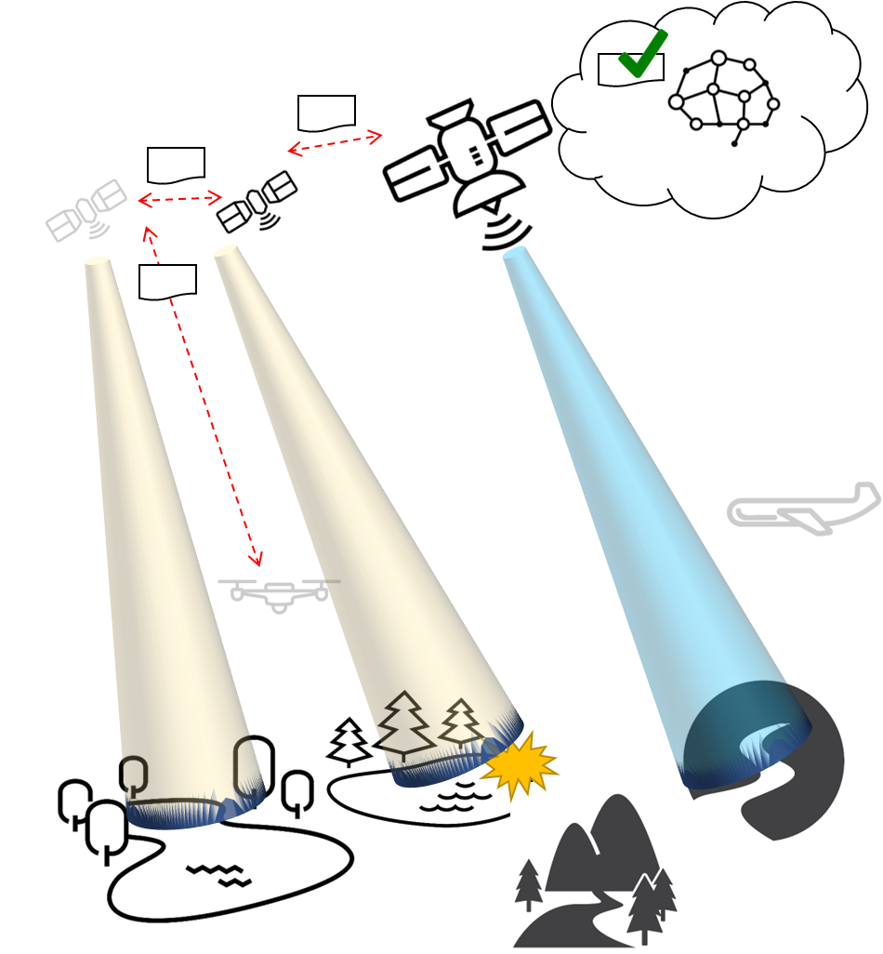
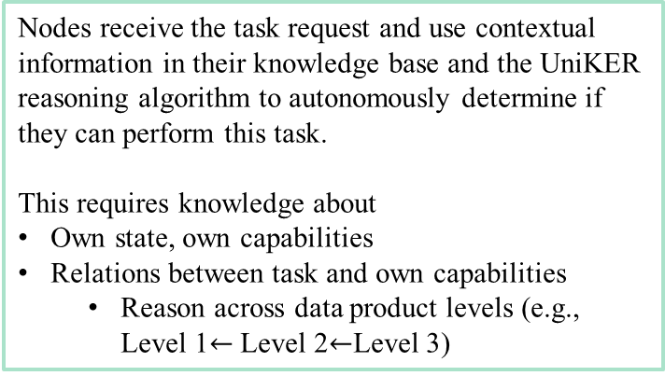
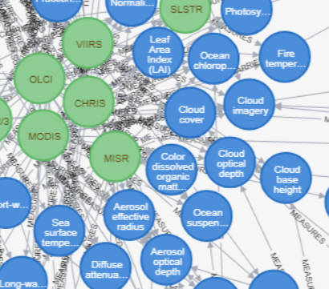
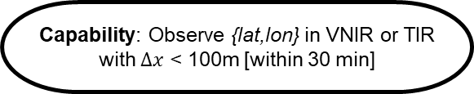
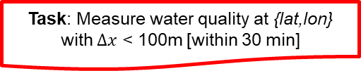
3D-CHESS: Concept of operations
3 – Instrument Capability Reasoning
CanBeObtainedFrom(WaterQuality, Chlorophyll-A)
CanBeObtainedFrom(Chlorophyll-A, VNIR_Radiances)

Slide 16
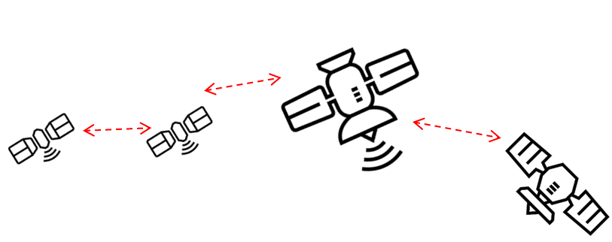
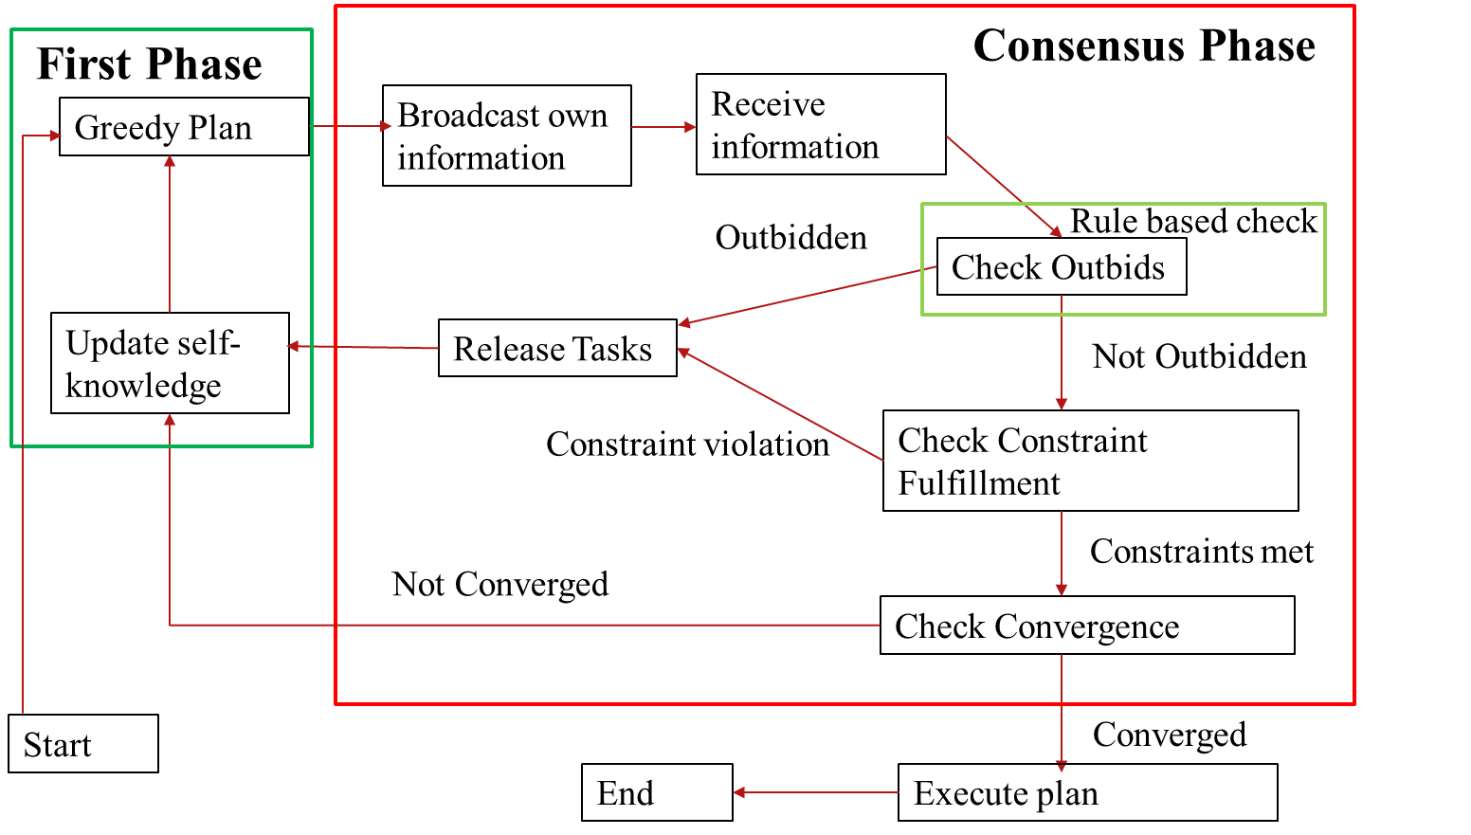
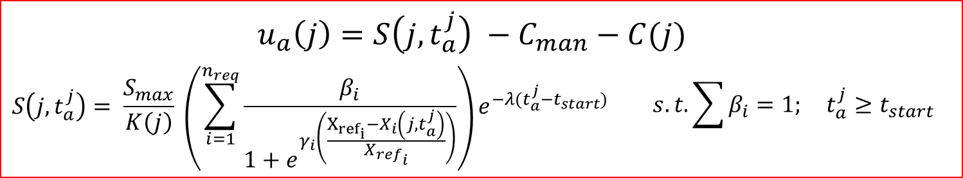
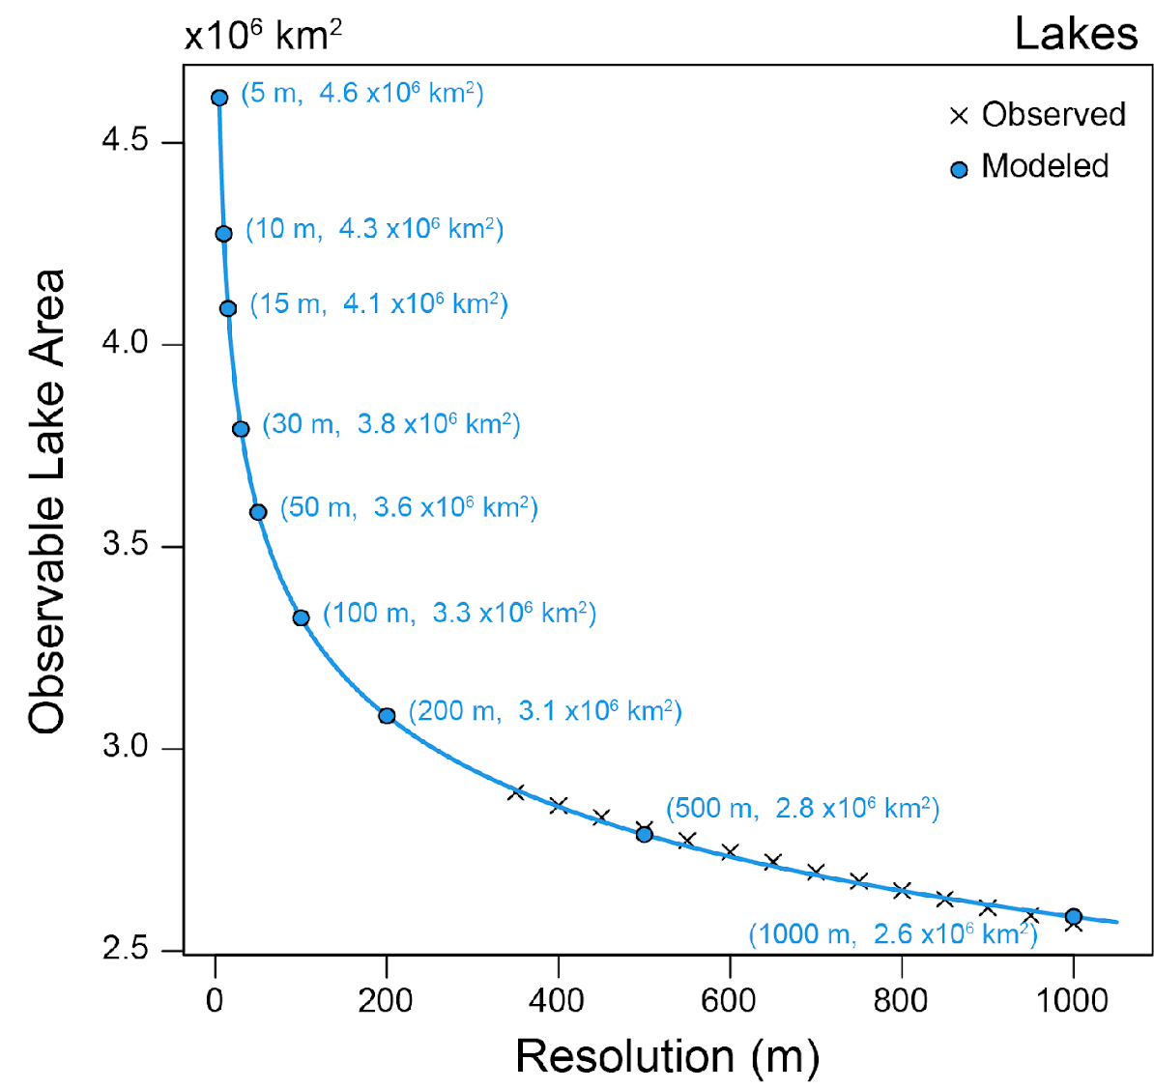
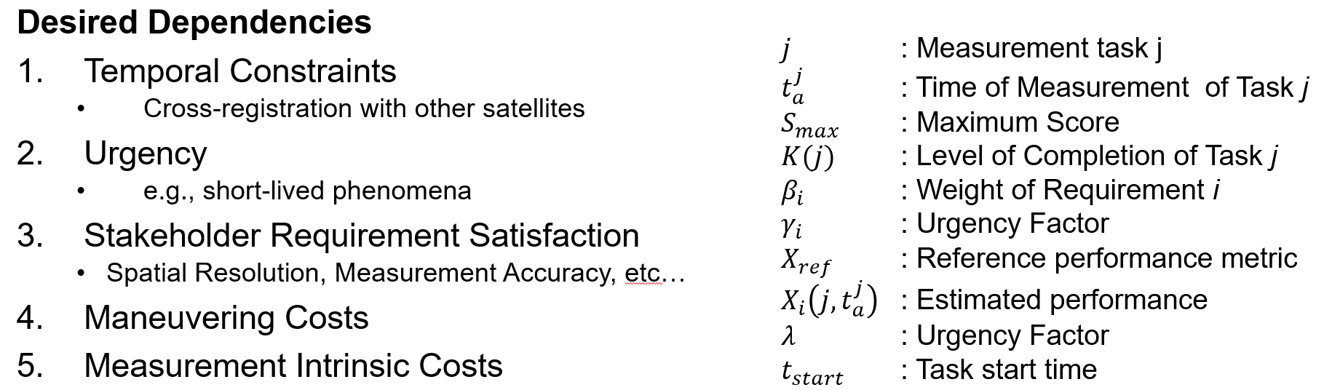
3D-CHESS: Concept of operations
4 – Decentralized planning
If they do, they enter a decentralized planning phase to coordinate who does what (MCCBBA algorithm).
Nodes use a science-driven utility function to determine if they should perform the task at the cost of temporarily abandoning their current mission. Engineering costs (e.g., energy) are also considered.
Once converged, the nodes update their plans.

Slide 17
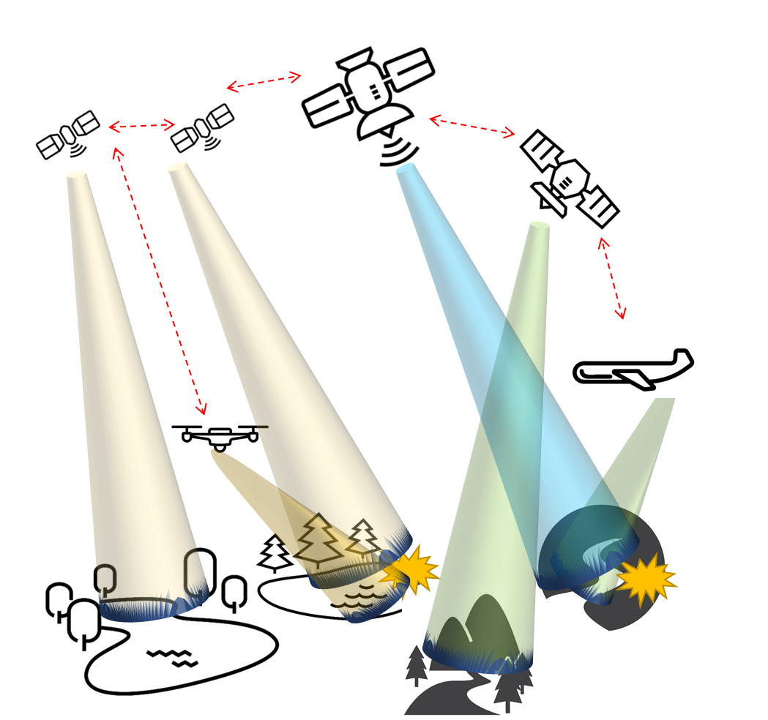
3D-CHESS: Concept of operations
5 – Updated plans; continue…
The pertinent nodes respond to the task request and the relevant images are taken and sent to the ground and/or the node that generated the task request.
The network continues to operate in this way. Nodes are added or removed from the network over time. Node states and the Earth system state change over time.
Nodes capabilities and relations between capabilities and tasks may also change slowly over time (e.g., new science discoveries!)

Slide 18
3D-CHESS TOOL ARCHITECTURE AND IMPLEMENTATION

Slide 19







3D-CHESS Architecture Overview
Env-to-agent
Sensing Data
Peer-to-peer
Data or Requests
Satellite Node
Environment Server
Peer broadcast
Data or Requests
Satellite Node
Manager broadcast
Sim start, end, or time
Broadcaster
Results Logger
Node Results
Node state, actions performed, events detected/measured, etc.
Simulation Manager
Ground Station Node
Satellite Node
3D-CHESS Nodes modeled as Agents
Environment modeled as a server to be accessed by nodes
Simulates Earth system AND agent state (e.g., position, velocity, comms accesses, coverage metrics)
Nodes “sense” the environment by requesting data from the environment server
Message-driven architecture. Agents exchange messages via TCP
Point-to-point (REQ/REP ports) for agent comms and agent-to-server sensing
Publish-subscribe (PUB/SUB ports) for note-to-node broadcasts and manager-to-nodes/environment simulation control messages
Push-pull (PUSH/PULL ports) for nodes and environment results logging
Time management can be Real-time, Accelerated real-time, or Event-driven.

Slide 20
Agent Node Architecture
Agent Node
Simulation Module
Sim Manager
-Simulation Events
SUB
Event Handler
Sim Start/End
-Simulation Events
-Measurement Results (from self or other agents)
-Information Request
Environment
REQ
Science Module
-GP access info
-GS access info
-Agent access info
-Agent state info
-Measurement observation metrics info
-Measurement Data (out)
-Measurement Requests
-Information Requests
REQ
Engineering Module
-Measurement Requests
-Information Requests
-Measurement Results
-Planner Results
-Agent State
-Planner Results (in)
-Measurement Requests (in)
Other Agents
SUB
Scheduler Module
-Scheduled Measurement Measurements
-Measurement Requests (out)
-Planner Results (out)
REP
PUSH
Results Logger
-Agent State
-Actions performed
-Events detected/measured
Message-Driven Internal Modules
Intra-agent modules modeled as concurrent asynchronous processes
Communicate by sending messages into asynchronous message queues

Slide 21
Agent Node architecture Engineering Module
Objective: Simulate the agent’s internal state and provide realistic behavior and capabilities based on its components and operations
Desired Capabilities:
Agent State Tracking
Sense and track agent’s external state (position, velocity, attitude, and eclipse)
Track agent’s internal state (power and data generation, storage, and consumption, component status, etc.)
React to environment events
i.e., turn off solar panels if eclipse event occurs
Scheduler Action Performance and Rejection
Receive and perform instructions from scheduler
Revert actions or even turn off agent if a critical state is reached
i.e., interrupt a measurement if power consumption from instruments exceeds generation
Instrument Simulation
Sense the environment
Provide realistic measurement results to science module
Network Simulator
Send and receive messages from/to other agents
Capture network delays
Due to transmission latency and data-rate
Due to buffer saturation
Agent Node
Simulation Module
Sim Manager
SUB
Event Handler
Sim Start/End
-Simulation Events
-Measurement Results (from self or other agents)
-Information Request
Env
REQ
Science Module
-Measurement Data (out)
-Measurement Requests
-Information Requests
Engineering Module
REQ
-Agent State
-Planner Results (in)
-Measurement Requests (in)
Other Agents
SUB
Scheduler Module
-Scheduled Measurement Measurements
-Measurement Requests (out)
-Planner Results (out)
REP
PUSH
Results Logger
DMAS Agent Node Framework

Slide 22
Agent Node architecture Engineering Module
Agent
Engineering Module - Initial Implementation :
Platform Emulator
Simulates the agent’s on-board subsystems
Command and Data Handling (CDH)
Receive commands to perform from planner
Track and manage agent’s internal memory state
React to the platform’s critical or failure states
Guidance Navigation and Control (GNC)
Sense and track agent’s position and velocity vector
Sense and track agent’s eclipse state
Electrical Power Subsystem (EPS)
Track power generation/consumption
Comms
Emulate transceiver buffers
Discards messages that cannot fit in buffers
Payload
Requests measurement information to the environment
Provides CDH with simulated instrument results from an observation
Network Emulator
Simulate latency due to range latency or channel data-rate
Simulation Maintenance Module
Sim Manager
Event Handler
-Simulation Events
Sim Start/End
Engineering Module
Platform Emulator
-Measurement Results (from self or other agents)
-Information Request
Environment
CDH
Science Module
-Agent access info
-Agent State
-State
-Data (out)
Memory Emulator
Reactive Planner
-Measurement Data (out)
-Measurement Requests (from self or towards out)
-Information Requests (out)
-Data Transmission Requests
-Emergency Task(s)
-Task(s)
-Tasks (for self or out)
-Measurement Requests (out)
-Information Requests (out)
-Measurement Results (out)
-Planner Results (out)
-Itemized task instructions
Operations Executor
-Pos/Vel info
GNC
-Subsystem State(s)
-Task completion status
Planning Module
-Agent State
-Planner Results (in)
-Measurement Requests (in)
Other Agents
Network Emulator
-Eclipse info
EPS
-Agent access info
Comms
-Received Data
-Msgs
Payload
-GP Measurement

Slide 23
Spacecraft Submodules
Command and Data Handling
Saves images from payload to memory
Monitors remaining storage capacity to check for future overflows
Guidance and Navigation
Gets position and velocity information from Environment, plus eclipse information
Electric Power Subsystem
Tracks which submodules are “on” and provides power
Monitors battery level and sends warnings when below a certain threshold
Payload
Gets images from Environment based on current orbit position and spacecraft attitude
Sends images to Command and Data Handling
Communications
RX/TX requests from other agents, checking access windows
Attitude Determination and Control
Slews spacecraft to proper angle to collect measurements based on a max slew rate and power consumption

Slide 24
Agent node architecture Scheduler Module
Objective: Simulate the agent’s internal state and provide realistic behavior and capabilities based on its components and operations
Agent Node
Simulation Module
Sim Manager
SUB
Event Handler
Sim Start/End
Desired Capabilities:
On-board Data Processing
Process raw data being sensed by the agent’s instrument
Process raw data sent from other agents who may lack processing capabilities
Create measurement requests for areas of interest
Create a data-base with measurements from parent agent or from other agents
Use data-base to detect areas of interest based on processed data
Use predictive models to infer possible future events in areas of interest
Request missing data as a measurement request or an information request to parent agent or to other agents if results would complete predictive model and if prediction would be worth the effort
Quantify Scientific Value of a Measurement
Use predictive models, data-base, and (or) mission requirements to infer the scientific benefit of a potential measurement being considered by the scheduler
-Simulation Events
-Measurement Results (from self or other agents)
-Information Request
Env
REQ
Science Module
-Measurement Data (out)
-Measurement Requests
-Information Requests
Engineering Module
REQ
-Agent State
-Planner Results (in)
-Measurement Requests (in)
Other Agents
SUB
Scheduler Module
-Scheduled Measurement Measurements
-Measurement Requests (out)
-Planner Results (out)
REP
PUSH
Results Logger
DMAS Agent Node Framework

Slide 25
Scheduler Module
Agent Node
Simulation Module
Sim Manager
Event Handler
-Simulation Events
Sim Start/End
Science Module
-Measurement Data (from self or in)
-Information Request (in)
-Measurement Data (out)
-Measurement Requests (from self)
Environment
Scheduler/Planning Module
-Measurement Requests (in)
Knowledge-Base Instrument Capability Reasoning
-Proposed measurements
Requirement Determination Reasoning
-Measurement Requirements
-Measurement Requests (out)
-Information Requests (out)
-Data Transmission Request (from self)
Engineering Module
-Agent State
-Planner Results (in)
-Proposed plan
-Agent state
-Tasks (for self or out)
-Measurement Requests (out)
-Information Requests (out)
-Measurement Results (out)
-Planner Results (out)
Observation Planning (Decentralized multiagent-level)
Operations Planning (agent-level)
-Modified plan
-Meas. Perf. Score
-Plan
-Agent state
Other Agents
Meas. Perf. Model
-Predicted observation metrics
Predictive Models
-Cost Estimate
Cost Model
-Predicted Agent States

Slide 26
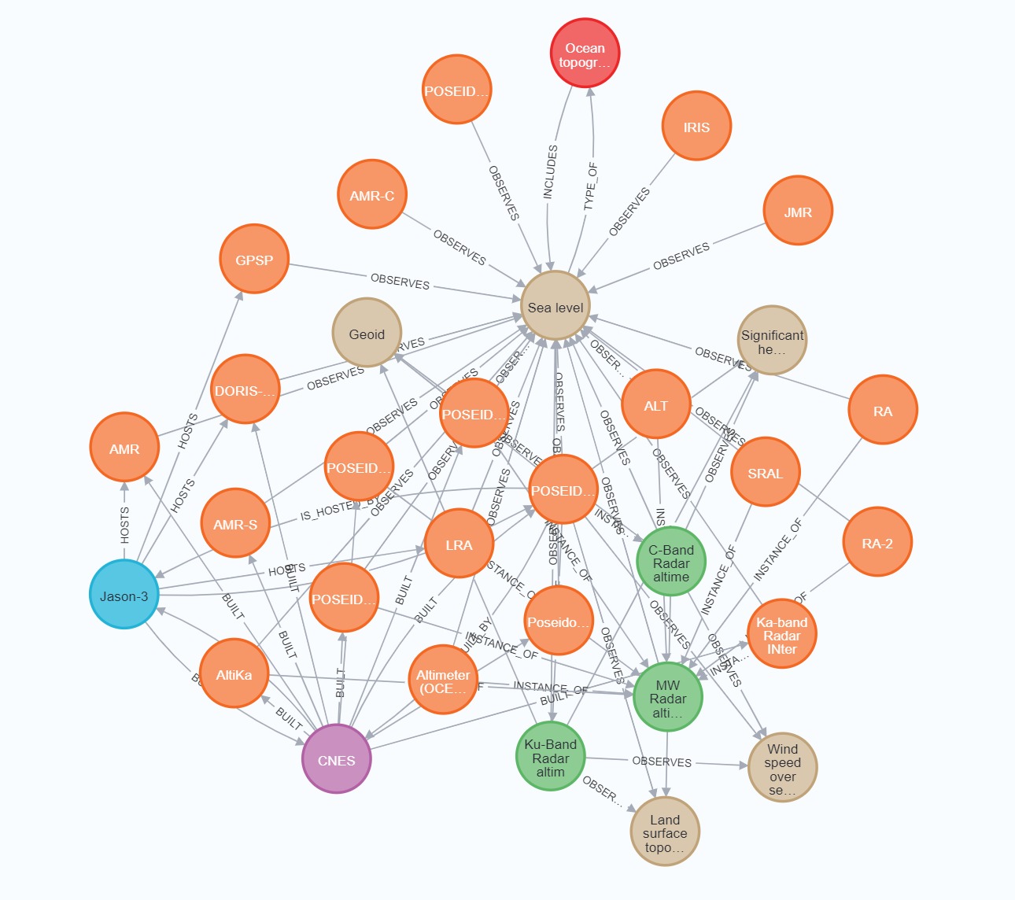
Knowledge Graph
KG types of entities and relations loosely based on Semantic Sensor Network ontology
BUILT, BUILT_BY, HOSTS, INCLUDES, INSTANCE_OF, IS_HOSTED_BY, OBSERVES, TYPE_OF
Data mined from CEOS database
Implemented in Neo4j
3,257 nodes; 14,914 relations
Example triplets:
Observes(POSEIDON-3B Altimeter, Sea level)
Instance_of(POSEIDON-3B Altimeter, Ku-band radar altimeter)
Next steps:
Add inland water quality parameters and non-satellite sensors (airborne, in-situ)
Add knowledge about how data products can be derived from other data products
Add uncertainty level to triplets + quantitative attributes

Slide 27










Decentralized Planning Strategy
2!
!
8!
3!
Task is announced
Bid Generation
Bid Sharing
Replanning
Consensus-Based Bundle Algorithm (CBBA)
Decentralized market-based planning approach
Nodes bid on measurement tasks using a science-driven utility function
Nodes iterate between two phases
Bundle-building phase
Bids are generated based on a node’s expected performance using their most recent task and bid information
Bids are saved in a bundle of a predefined length
Consensus phase
Agents broadcast their bid bundle and listen for other agents’ bids
If differences are found with the incoming bids, an agent will re-enter the bundle-building phase and re-plan using the newly acquired information
If not, consensus is inferred to have been reached
Winning bids represent final task assignment

Slide 28
Decentralized Planning Strategy
Modified Consensus Constraint-Based Bundle Algorithm (MCCBBA)
Requirement and Constraint satisfaction
Tasks may have dependencies on other tasks (i.e., assignment and time constraints)
Nodes can only bid on tasks if they satisfy the requirements and time constraints
If not, they may form coalitions with other nodes and perform a joint bid
Asynchronous Bid Sharing
Consensus phase and bundle-building phase occur asynchronously
Listener (Consensus phase) only informs bundle-builder of incoming bundles when they may impact the current bundle
Bundle-building phase only replans when new information is received from the listener
Nodes only share information when the listener deems it critical or when the bundle-builder creates a new bundle
Node
Bids
Consensus Phase
Other Nodes
Bundle-changing bids
Bundle-Builder
New
Bid Bundle
Asynchronous MCCBBA

Slide 29
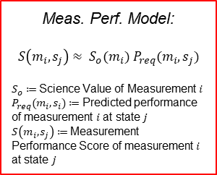
Scheduler Module
Agent Node
Simulation Module
Sim Manager
Event Handler
-Simulation Events
Sim Start/End
Science Module
-Measurement Data (from self or in)
-Information Request (in)
-Measurement Data (out)
-Measurement Requests (from self)
Environment
Scheduler/Planning Module
-Measurement Requests (in)
Knowledge-Base Instrument Capability Reasoning
-Proposed measurements
Requirement Determination Reasoning
-Measurement Requirements
-Measurement Requests (out)
-Information Requests (out)
-Data Transmission Request (from self)
Engineering Module
-Agent State
-Planner Results (in)
-Proposed plan
-Agent state
-Tasks (for self or out)
-Measurement Requests (out)
-Information Requests (out)
-Measurement Results (out)
-Planner Results (out)
Observation Planning (Decentralized multiagent-level)
Operations Planning (agent-level)
-Modified plan
-Meas. Perf. Score
-Plan
-Agent state
Other Agents
Meas. Perf. Model
-Predicted observation metrics
Predictive Models
-Cost Estimate
Cost Model
-Predicted Agent States

Slide 30
Agent node architecture Science Module
Agent Node
Objective: Schedule measurement requests according to the agent’s measurement capabilities and state
Simulation Module
Sim Manager
SUB
Event Handler
Sim Start/End
Desired Capabilities:
Consider Agent capabilities
Use Knowledge-Base to inform whether the agent can perform a measurement
Consider agent’s current and future state
Use engineering module for current state
Predict agent state as proposed scheduled actions are being performed
Schedule measurements as to maximize scientific value and minimize cost
Quantify the predicted scientific value of a measurement and schedule accordingly
Contain some sort of cost model that weighs down the value of measurements. Can be tied to the engineering cost of performing measurements
Publish and receive results to and from other agent if scheduling algorithm require collaboration with other agents
-Simulation Events
-Measurement Results (from self or other agents)
-Information Request
Env
REQ
Science Module
-Measurement Data (out)
-Measurement Requests
-Information Requests
Engineering Module
REQ
-Agent State
-Planner Results (in)
-Measurement Requests (in)
Other Agents
SUB
Scheduler Module
-Scheduled Measurement Measurements
-Measurement Requests (out)
-Planner Results (out)
REP
PUSH
Results Logger
DMAS Agent Node Framework

Slide 31
Science Module
Agent
Simulation Module
Science Module
Sim Manager
Event Handler
-Simulation Events
Sim Start/End
On-board Processor
-Processed data
Science “reasoning”
-Environment Events
-Model req/results
-Measurement Data (from self or in)
-Information Request
Science data-base
-Past data
Science Predictive Models
-Proposed Measurement Requests
-Proposed Information
Requests
-Mission Requirements
-Past measurement data
-Model req/results
Environment
Science Value Model
-Measurement Requests
-Information Request
Engineering Module
Other Agents
-Agent State
-Planner Results (in)
-Measurement Requests (in)
Scheduler Module
-Tasks (for self or out)
-Measurement Requests (out)
-Information Requests (out)
-Measurement Results (out)
-Planner Results (out)

Slide 32
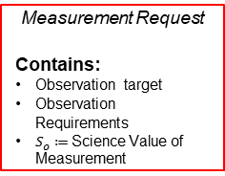
Science Module
Agent
Simulation Module
Science Module
Sim Manager
Event Handler
-Simulation Events
Sim Start/End
On-board Processor
-Processed data
Science “reasoning”
-Environment Events
-Model req/results
-Measurement Data (from self or in)
-Information Request
Science data-base
-Past data
Science Predictive Models
-Proposed Measurement Requests
-Proposed Information
Requests
-Mission Requirements
-Past measurement data
-Model req/results
Environment
Science Value Model
-Measurement Requests
-Information Request
Engineering Module
Other Agents
-Agent State
-Planner Results (in)
-Measurement Requests (in)
Scheduler Module
-Tasks (for self or out)
-Measurement Requests (out)
-Information Requests (out)
-Measurement Results (out)
-Planner Results (out)

Slide 33
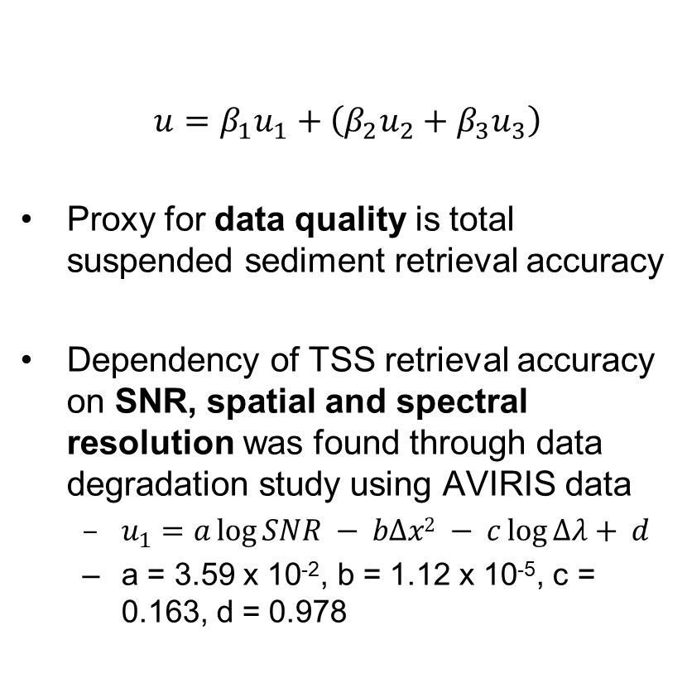
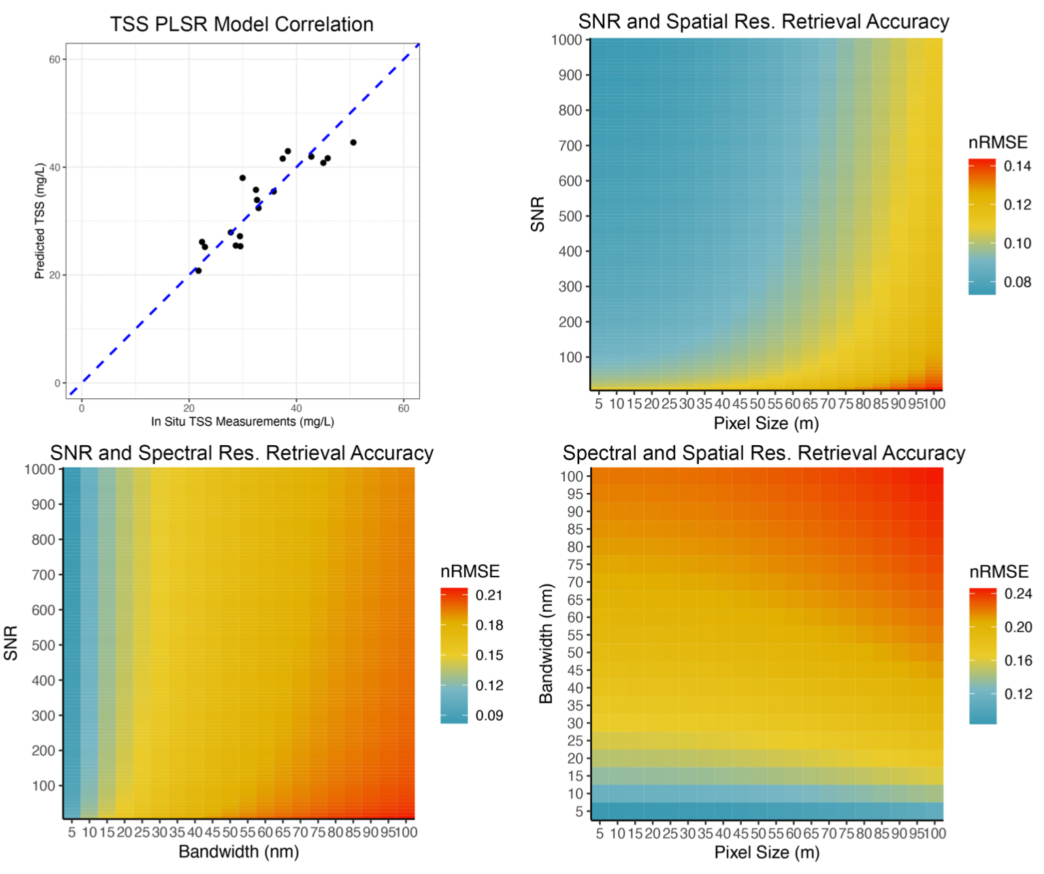
Science model Example – Data Quality
Science return function has multiple terms capturing data quantity and quality as a function of SNR and spatial/spectral/temporal resolution

Slide 34
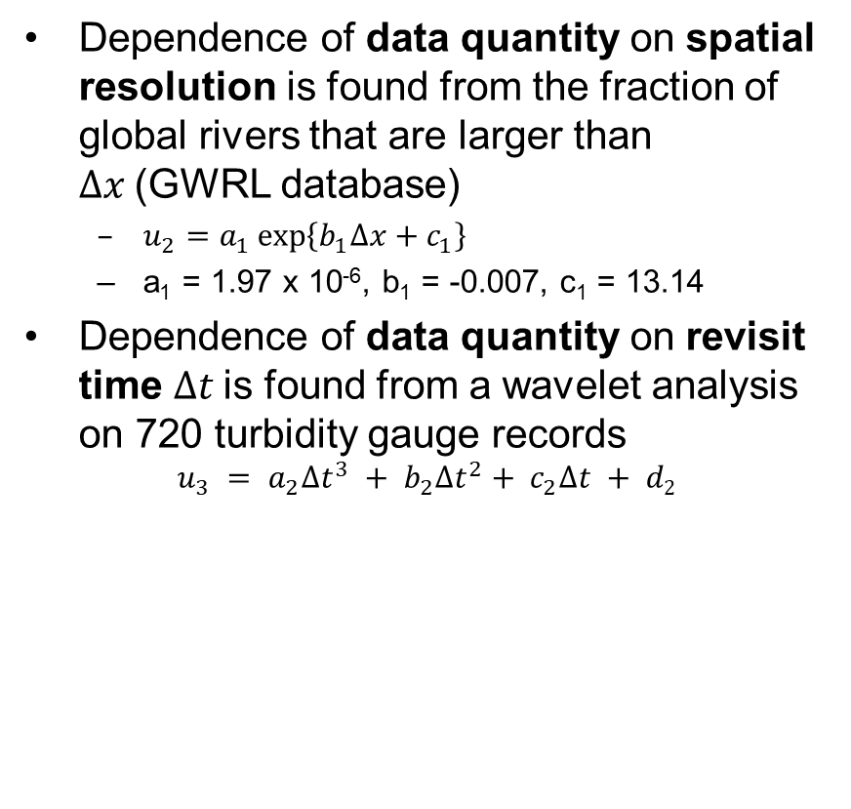
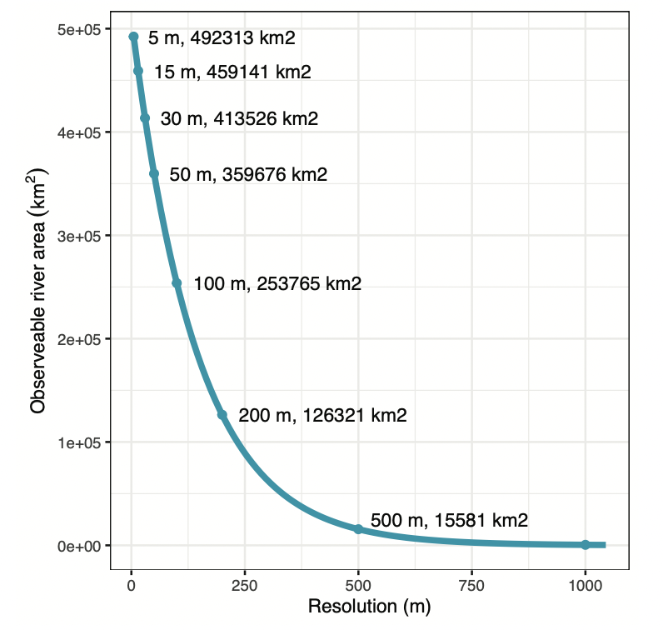
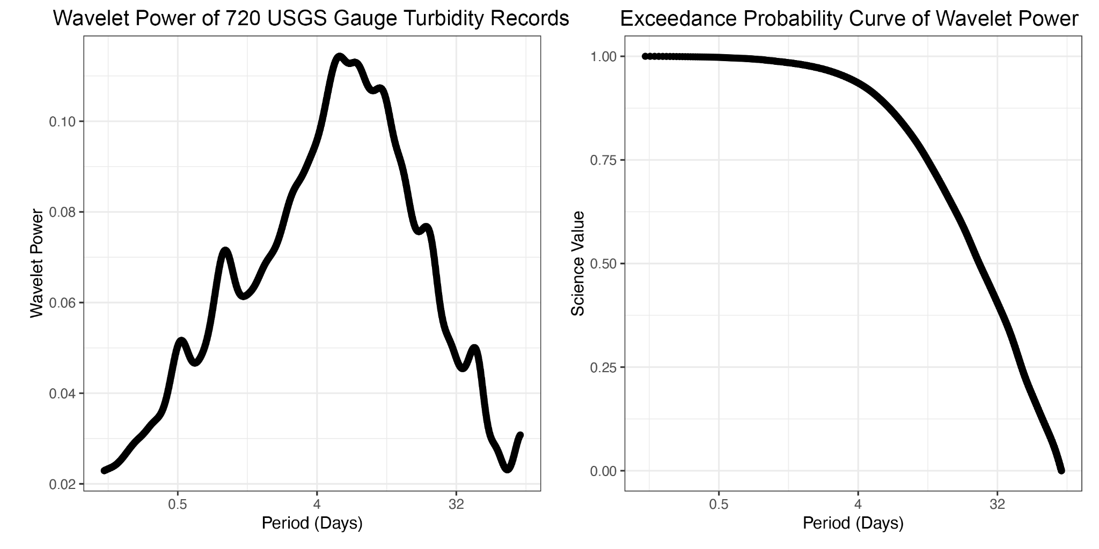
Science models – Data Quantity

Slide 35
Science Module – Chl example
Agent
Simulation Module
Science Module
Sim Manager
Event Handler
-Simulation Events
Sim Start/End
On-board Processor – 2BDA algorithm
-Chl-a product
Science “reasoning” – sees if chlorophyll concentration is above 1 standard deviation
-Environment Events
-Raw multi/hyperspectral images (from self or other agents)
Science data-base – past and current chlorophyll levels
-Past chl-a levels
Science Predictive Models – rainfall? Temperature? Historical?
-Chl-a outliers
-Observation metrics
-Algal bloom likelihood
-Mission Requirements
-Past measurement data
Environment
-Measurement Requests
-Information Request
-Measurement Data (from self)
Science Value Model
-Measurement Requests
-Information Request
Engineering Module
Other Agents
-Agent State
-Planner Results (in)
-Measurement Requests (in)
Scheduler Module
-Scheduled Measurement Measurements
-Measurement Requests (out)
-Planner Results (out)

Slide 36
PRELIMINARY RESULTS

Slide 37
Scenario 1: Flood TSS monitoring
Scenario goal: Obtain co-observations of water level + total suspended sediments during high flow events
Agents:
5 altimeters (Jason–3, Sentinel 6a-b, CryoSat-2, SWOT)
1 “taskable” VNIR+TIR imager (Landsat-9)
Fully connected network, zero latency (e.g., Iridium)
Altimeters check for floods, generate measurement request for flood locations when detected
1000 rivers from RiverATLAS database are initialized with random “flood” percentages between 0 and 1

Slide 38
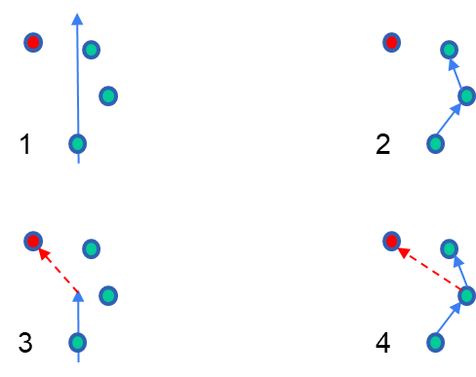
Scenario 1: Configurations
4 configurations
Configuration 1 “status quo/nadir”: imaging satellite points nadir
Configuration 2 “preplan; not responsive”: imaging satellite has a preset plan of maneuvers to see a maximum set of ground points, no knowledge of flood chance or occurrence
Configuration 3 “no preplan; responsive”: imaging satellite has no preset plan, but responds to requests generated by altimeters
Configuration 4 “preplan; responsive”: imaging satellite has a preset plan of maneuvers to see a maximum set of ground points PLUS responds to requests generated by altimeters
Variables:
Maximum slew rate from 0.1, 1, 10 deg/s
Percent of points flooded (10% or 50%)
Planner reward for known flood event vs any other point (10-1, 50-1)

Slide 39
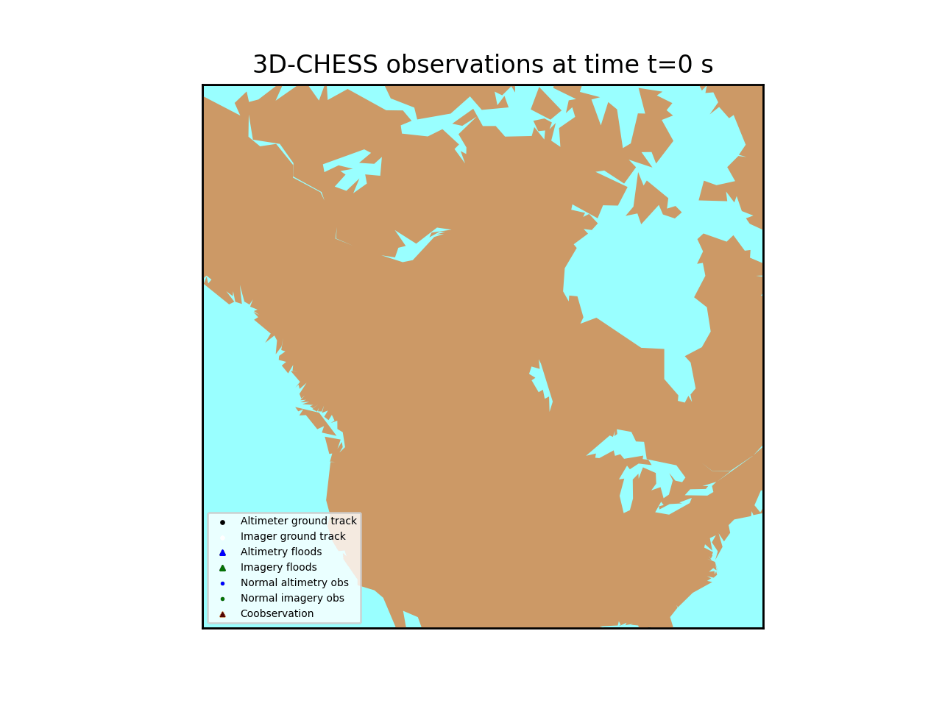
Scenario 1: Visualization

Slide 40
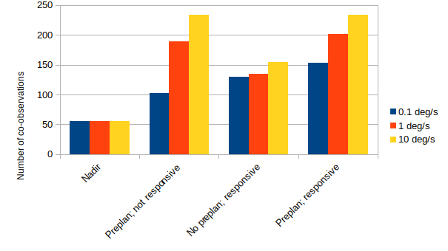
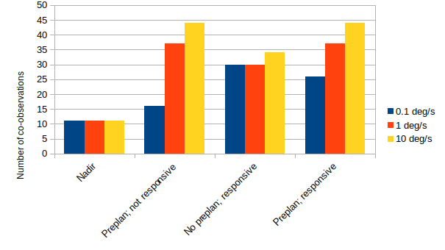
Scenario 1: Preliminary results
10% flood chance
50% flood chance
Both agility and responsiveness increase #co-observations w.r.t. status quo
Responsiveness is most useful for constellations with limited agility
For agile satellites, pre-planning w/o responsiveness seems sufficient
Next steps will investigate more complex observing strategies that incorporate science value and measurement uncertainty, as well as denser satellite networks

Slide 41
CONCLUSION

Slide 42
Major Next steps
Explore integration with NOS-T
Finalize integration and verification of initial tool
Incorporate MCCBBA and UniKER
Run scenario 2
Develop UAV and ground agents
Functionality Improvements
Decentralized Kalman
Incorporate uncertainty into KG reasoning
Baseline Performance characterization
Refine scenario 2
Define and run additional scenarios

Slide 43
Publications
1 Poster at AGU22
Selva, D., Allen, G. H., Gao, H., Gorr, B. J., Aguilar, A., Viros-i-Martin, A., Sun, Y., Mehta, A., Ravindra, V., David, C., & Stroud, M. (2022, December). Simulating A Context-aware Heterogeneous Sensor System for Monitoring Inland Waters and Ecosystems with 3D-CHESS. In Fall Meeting 2022. AGU.
2 papers under review at IGARSS23
A. Aguilar et al., Decentralized Market-based Measurement Assignment Strategy for Simultaneous Earth Observations for Distributed Heterogeneous Satellite Systems. Submitted to IGARSS23.
B. Gorr et al., Multi-Instrument Flood Monitoring With Distributed, Decentralized, Dynamic And Context-Aware Satellite Sensor Systems. Submitted to IGARSS23.

Slide 44
BACKUP

Slide 45
Acronyms
List of Acronyms
3D-CHESS Decentralized, Distributed, Dynamic, and Context-aware Heterogeneous Sensor Systems
DARPA Defense Advanced Research Projects Agency
KG Knowledge Graph
MCCBBA Modified Coupled-constraints Consensus Bundle-Based Algorithm
NISAR NASA-ISRO SAR Mission
RAPID Routing Application for Parallel computatIon of Discharge
SAR Synthetic Aperture Radar
SWOT Surface Water and Ocean Topography mission
TAMU Texas A&M University
TIR Thermal Infrared
TRL Technology Readiness Level
UCLA University of California Los Angeles
UniKER Unified framework combining Knowledge graph Embeddings and logical Rules
VASSAR Value Assessment of System Architectures using Rules
VNIR Visible and Near Infrared

Slide 46
Responses to Review Panel Comments
Would this work in operational practice? Scalability?
Assessing feasibility and scalability in the context of the relevancy scenario using the multi-agent simulator is in the research plan (Task 8)
Effectiveness in comparison to conventional systems?
Assessing scientific value/effectiveness compared to status quo is part of the research plan (specific scenarios and metrics defined in Task 1.3)
What is required for a node to detect and communicate an event of interest at a certain location: will there need to be a calibration step considered? Consensus understanding of an event’s location? Geolocation and pointing accuracy often a limitation.
Decentralized estimation module has been added to research plan (Tasks 4.3-4.4) and will be led by Dr. Mehta at UCLA. Impact of limited pointing accuracy and geolocation will be measured in Task 8.
Federation analysis characterization is not well defined.
We will study federations of agents where different nodes are owned and operated by different organizations in Task 8.7. Specific scenarios and metrics will be defined in Task 1.3.
Notes:
http://www.wolframalpha.com/input/?i=days+since+10th+October+2011

Slide 47
Responses to Review Panel Comments
Depth of the simulators?
The modeling fidelity of the platform simulators is medium to low in an “absolute” sense, but we think it is adequate for the goals of the project. The architecture is flexible so higher fidelity simulators can be substituted.
Role of predictive models to drive the sensor modes and sampling?
The role of predictive models is to anticipate events of interest (e.g., floods, algal blooms) before they are detected by the on board processors. They can lead to changes in the agent’s own plans (e.g., change in sensor modes and sampling) and/or the emission of new Task Requests (e.g., to add complementary observations of the location).
How is increased fidelity of observations leveraged via data assimilation by those models? Role of improved observations for model validation or calibration should be discussed more.
Increased fidelity of observations would result in improved accuracy and a reduction of uncertainty in the outputs of the science module, which will also result in better plans.
Notes:
http://www.wolframalpha.com/input/?i=days+since+10th+October+2011

Slide 48
Responses to Review Panel Comments
There is a scale mismatch between what is required for the four applications and the models that are referenced.
The models referenced were provided as examples and we are aware that they are not sufficient to develop the 4 applications. We will adopt an incremental approach, starting with “Extreme storage fluctuations in reservoirs”, then adding “Harmful Algal blooms”, etc. Models will be identified or developed as needed for the applications. The team has broad and deep expertise in science models for inland water applications.
For some of the phenomena outlined there may be significant latency between precipitation events and their impacts to be observed.
Predictive models such as the RAPID flow routing model should help capture this latency and incorporate it into the agents’ plans.

Slide 49
Responses to Review Panel Comments
When occluding clouds are detected or subsurface information is needed, then what strategy is invoked?
The effects of cloudiness will be modeled in the Earth system simulator and accounted for in the planning algorithms. There is no way around sensors’ fundamental limits, but the 3D-CHESS network should be able to coordinate among themselves so that the best available sensor performs a given task.
Large team, small time commitments, ambitious objectives, requires a lot of coordination. Effort for project management and overall cost may be too low. Significant schedule risk.
The research plan has flexibility in the number of applications we develop. We will take an incremental approach. The project is a natural extension of the team’s prior work.

Slide 50




Engineering Module - Plan Execution
Scenario:
2 Agents, one with instrument A and another with instrument B
1 GP of interest
Timeline:
Agent 1 performs routine measurement of GP1 with instrument A at T = 1
Agent 1 processes measurement and concludes GP1 is an area of interest for a measurement with instrument B
Agent 1 creates a measurement request for all agents in the network including itself
Agent 1 concludes that it does NOT possess the capabilities to perform the measurement request and therefore does not act on the request
Agent 1 attempts to send measurement request to Agent 2 at T = 2 but is unsuccessful (out of LOS)
Agent 1 sends measurement request to Agent 2 at T = 3
Agent 2 receives measurement request from Agent 1
Agent 2 concludes that it CAN perform the measurement in the request
Agent 2 schedules a measurement with instrument B at its next access to GP1 at T = 4
Agent 2 performs measurement
Agent 2 sends measurement results to Agent 1 at T = 4
Instr A
Instr B
1
2
GP1

Slide 51
Engineering Module - Plan Execution
Simulation Module
Sim Manager
Event Handler
-Simulation Events
Sim Start/End
Engineering Module
Platform Emulator
Environment
CDH
Science Module
Scenario step:
Agent 1 performs routine measurement of GP1 with instrument A
Disk Memory Emulator
Reactive Planner
Operations Executor
GNC
Planning Module
-Agent State
-Current time
Other Agents
Transmission Delay Emulator
EPS
Comms
Payload

Slide 52


Engineering Module - Plan Execution
1
Simulation Maintenance Module
Event Handler
-Simulation Events
Sim Start/End
SUB
Environment
Engineering Module
REQ
Platform Emulator
”Itemized plan:
-Wait for T=1
-Turn on instrument A
-Perform measurement
-Send data to science module”
CDH
Science Module
Scenario step:
Agent 1 performs routine measurement of GP1 with instrument A
Memory Emulator
Reactive Planner
Operations Executor
“Planning complete, perform routine plan!”
-Task: “Measure GP1 with Instrument A at T=1”
REP
GNC
Planning Module
Other Agents
Network Emulator
EPS
REQ
Comms
Payload

Slide 53

Engineering Module - Plan Execution
1
Simulation Maintenance Module
Event Handler
-Simulation Events
Sim Start/End
SUB
Environment
Engineering Module
REQ
Platform Emulator
CDH
Science Module
Scenario step:
Agent 1 performs routine measurement of GP1 with instrument A
Memory Emulator
Reactive Planner
“T is now T=1!”
-”Turn on Instrument A”
Operations Executor
REP
GNC
Planning Module
Other Agents
Network Emulator
EPS
REQ
Comms
“Turning on instrument A…"
Payload

Slide 54

Engineering Module - Plan Execution
1
Simulation Maintenance Module
Event Handler
-Simulation Events
Sim Start/End
“Accessing data for GP1 at T=1…
Data found! Sending to Agent 1…”
SUB
Environment
Engineering Module
REQ
-GP Data
Platform Emulator
CDH
Science Module
Scenario step:
Agent 1 performs routine measurement of GP1 with instrument A
Memory Emulator
Reactive Planner
Operations Executor
REP
GNC
Planning Module
Other Agents
Network Emulator
EPS
REQ
Comms
“Performing measurement. Requesting info from environment…”
Payload
-GP Data

Slide 55
Engineering Module - Plan Execution
1
Simulation Maintenance Module
Event Handler
-Simulation Events
Sim Start/End
SUB
Environment
Engineering Module
REQ
“Measurement data is now stored in internal memory!”
Platform Emulator
CDH
Science Module
Scenario step:
Agent 1 performs routine measurement of GP1 with instrument A
Memory Emulator
Reactive Planner
Operations Executor
REP
GNC
Planning Module
Other Agents
Network Emulator
EPS
REQ
Comms
“Measurement performed! Saving results…”
Payload
-Instrument Data

Slide 56
Engineering Module - Plan Execution
1
Simulation Maintenance Module
Event Handler
-Simulation Events
Sim Start/End
SUB
Environment
“Processing results…
GP1 should be measured with Instrument B!”
Engineering Module
REQ
“Sending results for processing…”
Platform Emulator
CDH
-Instrument Data
Science Module
Scenario step:
Agent 1 processes measurement and concludes GP1 is an area of interest for a measurement with instrument B
Memory Emulator
Reactive Planner
Operations Executor
REP
GNC
Planning Module
Other Agents
Network Emulator
EPS
REQ
Comms
Payload

Slide 57
Engineering Module - Plan Execution
1
Simulation Maintenance Module
Event Handler
-Simulation Events
Sim Start/End
SUB
Environment
Engineering Module
REQ
Platform Emulator
CDH
Science Module
Scenario step:
Agent 1 creates a measurement request for all agents in the network including itself
Memory Emulator
Reactive Planner
-Measurement Requests (to self): “Measure GP1 with Instrument B”
-Measurement Requests (to all): “Measure GP1 with Instrument B”
Operations Executor
REP
GNC
Planning Module
Other Agents
Network Emulator
EPS
REQ
Comms
Payload

Slide 58
Engineering Module - Plan Execution
1
Simulation Maintenance Module
Event Handler
-Simulation Events
Sim Start/End
SUB
Environment
Engineering Module
REQ
Platform Emulator
CDH
Science Module
Scenario step:
Agent 1 concludes that it does NOT possess the capabilities to perform the measurement request and therefore does not act on the request
Memory Emulator
Reactive Planner
-Measurement Requests (to self): “Measure GP1 with Instrument B”
Operations Executor
REP
GNC
Planning Module
Other Agents
Network Emulator
EPS
REQ
“I do not have instrument B therefore I cannot perform this request.”
Comms
Payload

Slide 59
Engineering Module - Plan Execution
1
Simulation Maintenance Module
Event Handler
-Simulation Events
Sim Start/End
SUB
Environment
Engineering Module
REQ
Platform Emulator
CDH
Science Module
Scenario step:
Agent 1 sends measurement request to Agent 2
Memory Emulator
Reactive Planner
Operations Executor
-Measurement Requests (to all): “Measure GP1 with Instrument B”
REP
GNC
Planning Module
Other Agents
Network Emulator
EPS
REQ
Comms
“Scheduling measurement request broadcast for next access with Agent 2 at T=2”
Payload

Slide 60
Engineering Module - Plan Execution
1
Simulation Maintenance Module
Event Handler
-Simulation Events
Sim Start/End
SUB
Environment
Engineering Module
REQ
”Itemized plan:
-Place message in comms buffer
-Wait for T=2
-Wait for access to Agent 2
-Transmit message
-Delete message from buffer”
Platform Emulator
CDH
Science Module
Scenario step:
Agent 1 sends measurement request to Agent 2
Memory Emulator
Reactive Planner
Operations Executor
-Task: “Send Measurement req to Agent 2 at T=2”
“Planning complete, perform plan!”
REP
GNC
Planning Module
Other Agents
Network Emulator
EPS
REQ
Comms
Payload

Slide 61
Engineering Module - Plan Execution
1
Simulation Maintenance Module
Event Handler
-Simulation Events
Sim Start/End
SUB
Environment
Engineering Module
REQ
Platform Emulator
CDH
Science Module
Scenario step:
Agent 1 sends measurement request to Agent 2
Memory Emulator
Reactive Planner
-Measurement Request Message
Operations Executor
REP
GNC
Planning Module
“Outgoing message placed in buffer. Updating current buffer state…”
Other Agents
Network Emulator
EPS
REQ
Comms
Payload

Slide 62
Engineering Module - Plan Execution
1
Simulation Maintenance Module
Event Handler
-Simulation Events
Sim Start/End
SUB
Environment
Engineering Module
REQ
Platform Emulator
CDH
Science Module
Scenario step:
Agent 1 sends measurement request to Agent 2
Memory Emulator
Reactive Planner
“T is now T=2!”
-“Wait for access to agent 2”
Operations Executor
REP
GNC
Planning Module
“Waiting for access to agent 2…
Polling environment until access is confirmed…”
Other Agents
Network Emulator
EPS
REQ
Comms
Payload

Slide 63
Engineering Module - Plan Execution
1
Simulation Maintenance Module
Event Handler
-Simulation Events
Sim Start/End
“Accessing agent data for Agents 1 and 2 at T=2…
Data found! Sending to Agent 1…”
SUB
Environment
Engineering Module
REQ
-Agent Access Info
Platform Emulator
CDH
Science Module
Scenario step:
Agent 1 sends measurement request to Agent 2
Memory Emulator
Reactive Planner
Operations Executor
REP
GNC
Planning Module
Other Agents
Network Emulator
EPS
“Agent 2 is NOT accessible. Trying again at T = 3…”
REQ
-Agent Access Info
Comms
Payload

Slide 64
Engineering Module - Plan Execution
1
Simulation Maintenance Module
Event Handler
-Simulation Events
Sim Start/End
“Accessing agent data for Agents 1 and 2 at T=3…
Data found! Sending to Agent 1…”
SUB
Environment
Engineering Module
REQ
-Agent Access Info
Platform Emulator
CDH
Science Module
Scenario step:
Agent 1 sends measurement request to Agent 2
Memory Emulator
Reactive Planner
“T is now T=3!”
Operations Executor
REP
GNC
Planning Module
Other Agents
Network Emulator
EPS
“Agent 2 is now accessible!”
REQ
-Agent Access Info
Comms
Payload

Slide 65
Engineering Module - Plan Execution
1
Simulation Maintenance Module
Event Handler
-Simulation Events
Sim Start/End
SUB
Environment
Engineering Module
REQ
Platform Emulator
CDH
Science Module
Scenario step:
Agent 1 sends measurement request to Agent 2
Memory Emulator
“T is now T=3 and Agent 2 is accessible!”
Reactive Planner
-“Send measurement request to agent 2”
Operations Executor
-Measurement Request
REP
GNC
Planning Module
Other Agents
Network Emulator
EPS
“Sending message…”
REQ
Comms
-Measurement Request
Payload

Slide 66

Engineering Module - Plan Execution
2
Simulation Maintenance Module
Event Handler
-Simulation Events
Sim Start/End
SUB
Environment
Engineering Module
REQ
Platform Emulator
CDH
“Received a measurement request. Forwarding to Planning Module…”
Science Module
Scenario step:
Agent 2 receives measurement request from Agent 1
Memory Emulator
Reactive Planner
Operations Executor
REP
GNC
Planning Module
Other Agents
Network Emulator
EPS
“Received a message from Agent 1!”
-Measurement Request
REQ
Comms
-Measurement Request
Payload
-Received Data

Slide 67


Engineering Module - Plan Execution
2
Simulation Maintenance Module
Event Handler
-Simulation Events
Sim Start/End
SUB
Environment
Engineering Module
REQ
Platform Emulator
CDH
Science Module
Scenario step:
Agent 2 concludes that it CAN perform the measurement in the request
Memory Emulator
Reactive Planner
Operations Executor
REP
GNC
Planning Module
-Agent State
-Measurement Requests: “Measure GP1 with Instrument B”
Other Agents
Network Emulator
EPS
REQ
Comms
“I have instrument B, therefore I CAN perform this measurement request”
Payload

Slide 68
Engineering Module - Plan Execution
2
Simulation Maintenance Module
Event Handler
-Simulation Events
Sim Start/End
SUB
Environment
Engineering Module
REQ
Platform Emulator
CDH
Science Module
Scenario step:
Agent 2 schedules a measurement with instrument B at its next access to GP1 at T=4
Memory Emulator
Reactive Planner
Operations Executor
REP
GNC
Planning Module
Other Agents
Network Emulator
EPS
REQ
Comms
“Scheduling measurement of GP1 with Instrument B at T=4”
Payload

Slide 69

Engineering Module - Plan Execution
2
Simulation Maintenance Module
Event Handler
-Simulation Events
Sim Start/End
SUB
Environment
Engineering Module
REQ
”Itemized plan:
-Wait for T=4
-Turn on instrument B
-Perform measurement
-Send data to science module
-Send data to Agent 1
Platform Emulator
CDH
Science Module
Scenario step:
Agent 2 performs measurement
Memory Emulator
Reactive Planner
Operations Executor
-Task: “Measure GP1 with Instrument B at T=B”
“Planning complete, perform plan!”
REP
GNC
Planning Module
Other Agents
Network Emulator
EPS
REQ
Comms
Payload

Slide 70
Engineering Module - Plan Execution
2
Simulation Maintenance Module
Event Handler
-Simulation Events
Sim Start/End
SUB
Environment
Engineering Module
REQ
Platform Emulator
CDH
Science Module
Scenario step:
Agent 2 performs measurement
Memory Emulator
Reactive Planner
“T is now T=4!”
-”Turn on Instrument B”
Operations Executor
REP
GNC
Planning Module
Other Agents
Network Emulator
EPS
REQ
Comms
“Turning on instrument B…"
Payload

Slide 71

Engineering Module - Plan Execution
2
Simulation Maintenance Module
Event Handler
-Simulation Events
Sim Start/End
“Accessing data for GP1 at T=4…
Data found! Sending to Agent 2…”
SUB
Environment
Engineering Module
REQ
-GP Data
Platform Emulator
CDH
Science Module
Scenario step:
Agent 2 performs measurement
Memory Emulator
Reactive Planner
Operations Executor
REP
GNC
Planning Module
Other Agents
Network Emulator
EPS
REQ
Comms
“Performing measurement. Requesting info from environment…”
Payload
-GP Data

Slide 72
Engineering Module - Plan Execution
2
Simulation Maintenance Module
Event Handler
-Simulation Events
Sim Start/End
SUB
Environment
Engineering Module
REQ
“Measurement data is now stored in internal memory!”
Platform Emulator
CDH
Science Module
Scenario step:
Agent 2 performs measurement
Memory Emulator
Reactive Planner
Operations Executor
REP
GNC
Planning Module
Other Agents
Network Emulator
EPS
REQ
Comms
“Measurement performed! Saving results…”
Payload
-Instrument Data

Slide 73

Engineering Module - Plan Execution
2
Simulation Maintenance Module
Event Handler
-Simulation Events
Sim Start/End
SUB
Environment
“Processing results…
Higher level products obtained. No new event detected.”
Engineering Module
REQ
“Sending results for processing…”
Platform Emulator
CDH
-Instrument Data
Science Module
Scenario step:
Agent 2 performs measurement
Memory Emulator
Reactive Planner
Operations Executor
REP
GNC
Planning Module
Other Agents
Network Emulator
EPS
REQ
Comms
Payload

Slide 74
Engineering Module - Plan Execution
2
Simulation Maintenance Module
Event Handler
-Simulation Events
Sim Start/End
SUB
Environment
Engineering Module
REQ
Platform Emulator
CDH
-Instrument Data
Science Module
Scenario step:
Agent 2 sends measurement results to Agent 1 at T = 4
“Sending results to Agent 1”
Memory Emulator
Reactive Planner
-”Send measurement results to Agent 1”
-Measurement results
Operations Executor
-Measurement Results
REP
GNC
Planning Module
Other Agents
Network Emulator
EPS
“Sending data to Agent 1…”
REQ
Comms
-Measurement Results
Payload

Slide 75
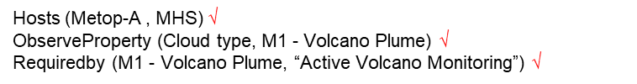
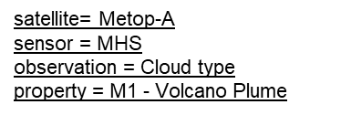
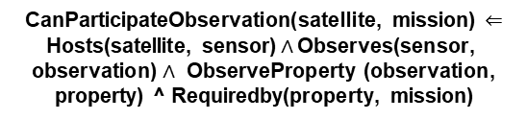
UniKER: A Unified Framework for Combining Embedding and Definite Horn Rule Reasoning for Knowledge Graph Inference
Embedding learning
MHS
Observes
New fact inference
Cloud type
Mission = “Active Volcano Monitoring”
Add into KG
Infer successfully
canParticipateObservation (Metop-A , “Active Volcano Monitoring”)

Slide 76
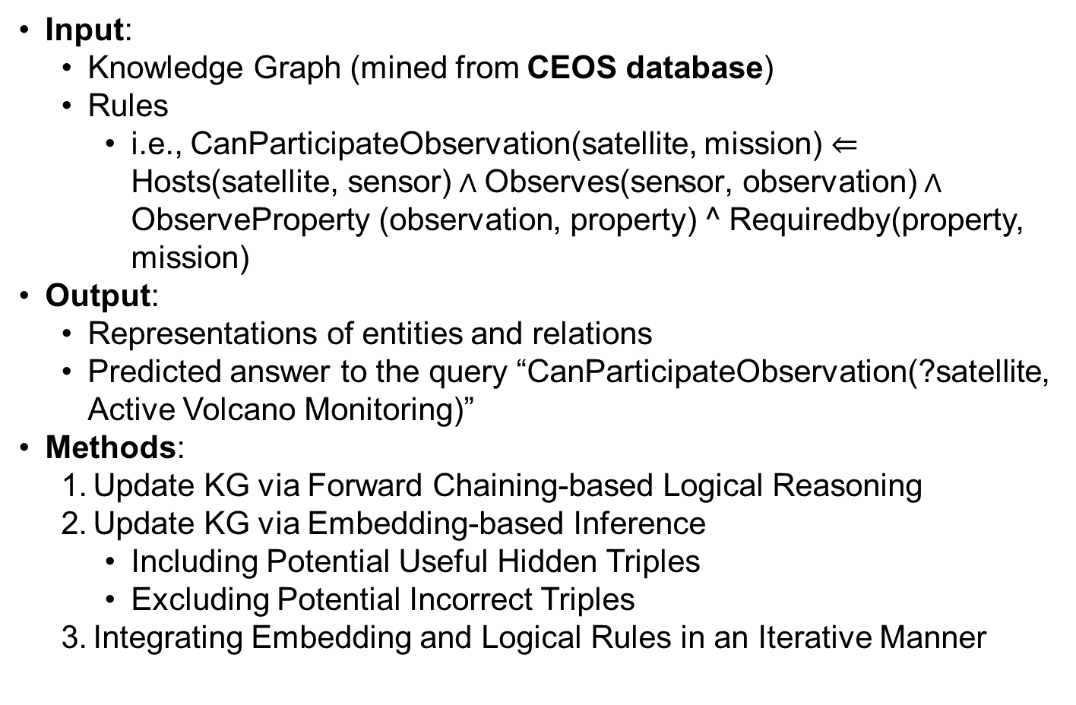
UniKER: A Unified Framework for Combining Embedding and Definite Horn Rule Reasoning for Knowledge Graph Inference

Slide 77
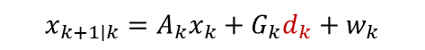
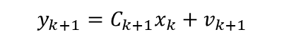

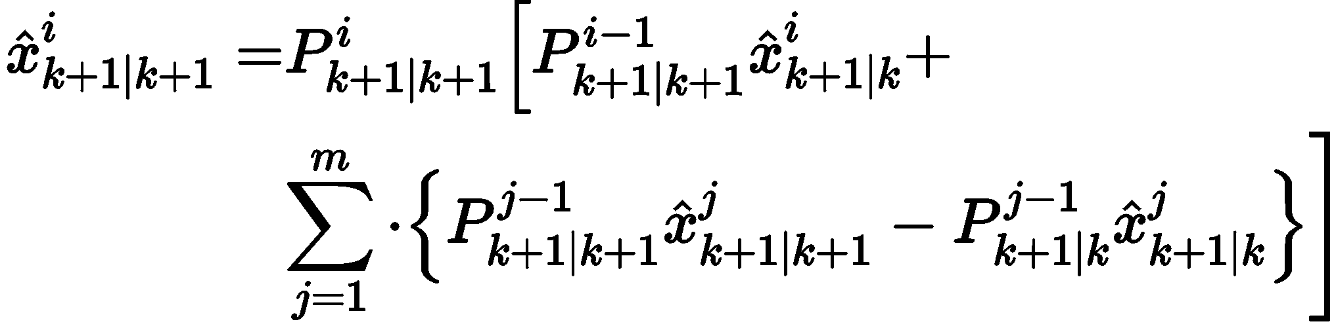
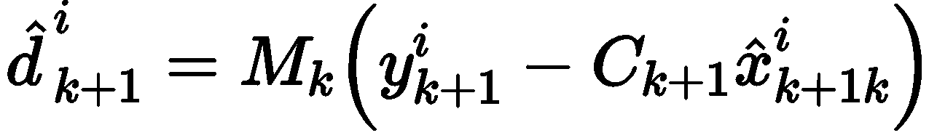
Decentralized Kalman Filter for Event Estimation
Decentralized Event and State Estimation
System Model of Individual Agent:
Prediction
Measurement
Flood point
state
own estimation
Estimation task depicture
State Estimation
Observation
System
Estimator
States (water body )
Communication
Event (flood)
Compensation through communication
Individual estimator structure
Event Estimation
Event

